Slide 1
CMSC201 Computer Science I for Majors Lecture 27 – Final Exam Review

Slide 2
Office Hours
Tuesday (May 16th) is the last day that office hours will be held
Study Day is Wednesday (May 17th)

Slide 3
Exam Rules
The final is closed everything:
No books
No notes
No cheat sheets
No laptops
No calculators
No phones

Slide 4
Exam Rules
Place your bag under your desk/chair
NOT on the seat next to you
You may have on your desk:
Pencils, erasers
You must use a pencil, not a pen
Water bottle
UMBC ID
You must bring your UMBC ID with you to the exam! We won’t accept your test without it.

Slide 5
Exam Rules
Your TA or instructor may ask you to move at any time during the test
This doesn’t mean we think you’re cheating
That being said, DO NOT CHEAT!!!
Cheating will be dealt with severely and immediately
If a TA or instructor sees you looking at another student’s paper they may take your test from you

Slide 6
Exam Seating
Space allowing, you will sit every other seat, so that you are not next to another student
Your instructor may have specific instructions for their lecture hall seating arrangements
Make sure you know how to get to your exam room location – arrive early if possible!

Slide 7
Exam Time and Locations
Final Exam will held be on Friday, May 19th from 6:00 to 8:00 PM
Being held in two separate rooms
ENGR 027 – Sections 2, 3, 4, 5, 15, 16, 18
Dr. Gibson’s sections
MEYR 030 – Sections 9, 10, 11, 12, 20, 21, 22, 23
Dr. Wilson’s sections
Make sure you go to the correct room!

Slide 8
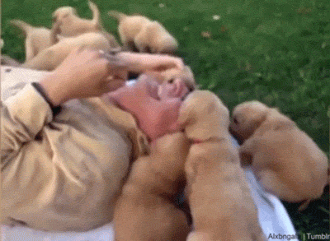
Questions about Exam Rules?

Slide 9
Exam Format
Similar to the midterm
Going over the slides and making sure you are comfortable with the material would be a good idea
Try some of the exercises and practice examples available in the slides
Very similar to the in-class worksheet
Questions are less “tricky” than the worksheet, but the types of questions are generally the same

Slide 10
Exam Format
Multiple Choice
True/False
Code evaluation
Given code, what does it do?
Debugging
Find and fix errors
Fill in the blank
Complete a piece of partially-written code

Slide 11
Exam Format
Programming problems
Given a problem, write the code to solve it
Tips:
Don’t jump straight into coding
Read the question carefully
Plan out what your code needs to do

Slide 12
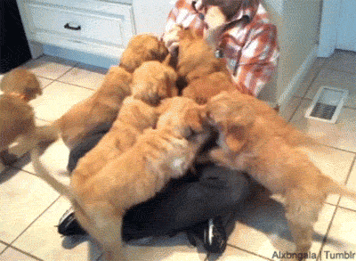
Questions about Exam Format?

Slide 13
Exam Content
Everything we covered at the beginning!
From the midterm, you should be familiar with:
Evaluating expressions
Control structures
While Loops (including Interactive loops)
If/Elif/Else
Lists
Indexing and appending

Slide 14
Exam Content
From the midterm, you should be familiar with:
Debugging
Strings
String functions like split() and strip()
Functions
Passing and returning variables

Slide 15
Exam Content
Everything else we’ve covered so far!
You should be especially familiar with:
For loops (and range)
File I/O
Data structures (tuples and dictionaries)
Decimal <-> Binary conversion
Recursion
Classes (conceptual only)

Slide 16
Exam Content
You should be especially familiar with:
Algorithms and analysis
Searching algorithms
Linear & Binary
Sorting algorithms
Selection Sort, Bubble Sort, & Quicksort
Multi-dimensional lists
2D and 3D lists
Printing, creating, manipulating
You should understand how they work, and know their run times

Slide 17
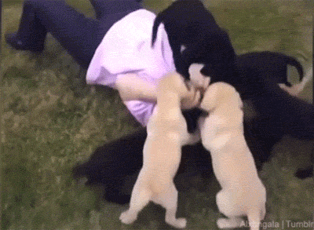
Questions about Exam Content?

Slide 18
Exam Advice
Write down your name and circle your section
Flip through the exam and get a feel for the length of it and the types of questions
If a problem is unclear or you think there is an error on the exam, raise your hand

Slide 19
Exam Advice
Some questions have partial credit
You should at least attempt every problem
If you don’t know how to do one part of the problem, skip it and do the rest
Make sure to pace yourself – this exam is longer than the midterm!

Slide 20
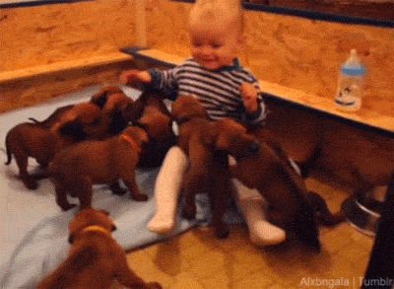
Any Other Questions?

Slide 21
Review Worksheet Answers
Answers will not be provided
Work with other students on the review sheet!
You’ll understand and retain the information better if you solve the problems yourself

Slide 22
Announcements
Survey #4 will come out Saturday morning
Will be due Wed, May 24th @ 11:59 PM
Similar to Survey #1, which asked about your performance on and prep for the midterm exam
TAs have volunteered to do out-of-class reviews
Tuesday from 7 to 9 PM (ITE 233)
Wednesday from 7 to 9 PM (ITE 233)

